Slide 1
Unit Test with Spock

Slide 2
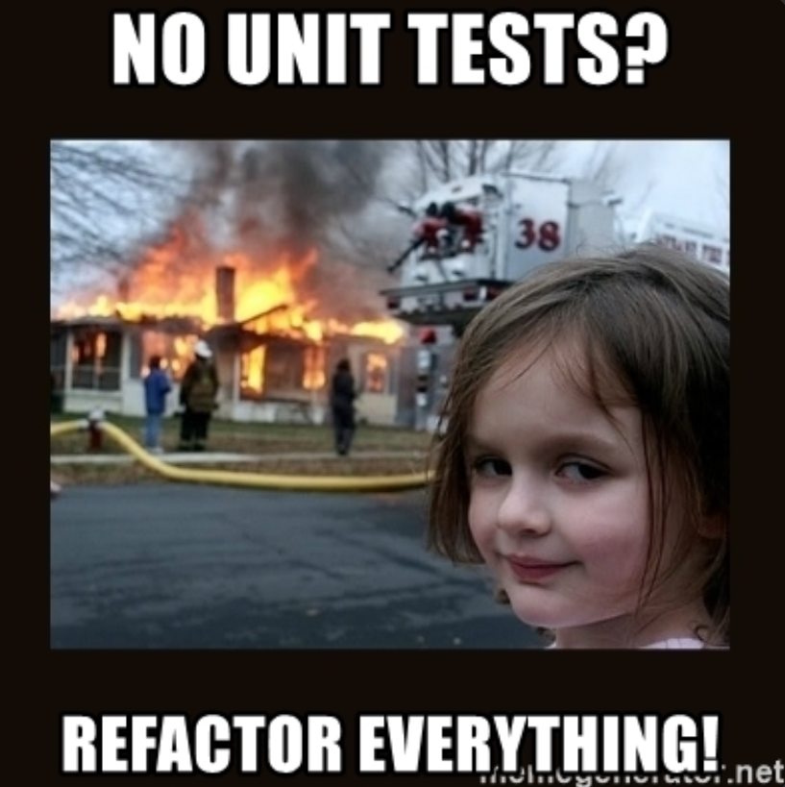

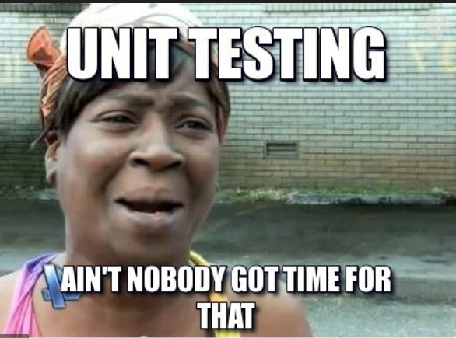
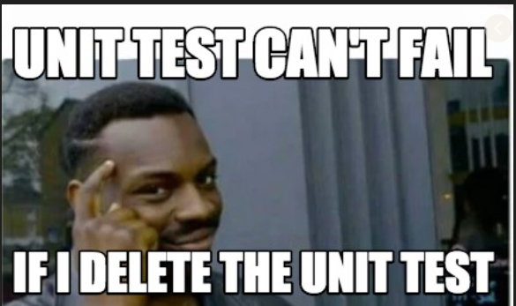
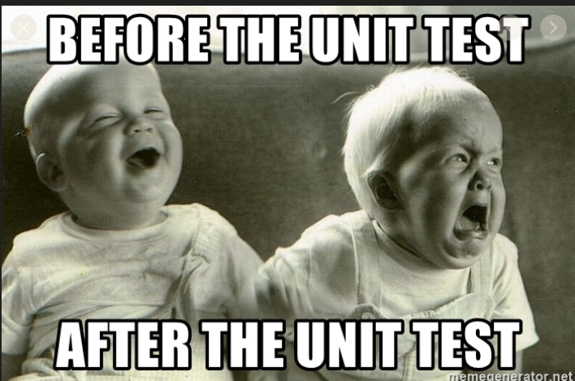

Writing Unit Test

Slide 3

Describes Behavior of System
Readable – Well Documented
Easy to Learn
Easy and Fast to Write / Debug
Maintainable Unit Test

Slide 4
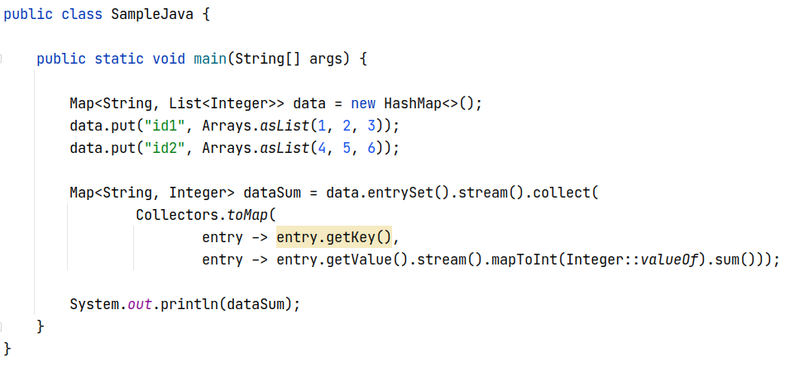
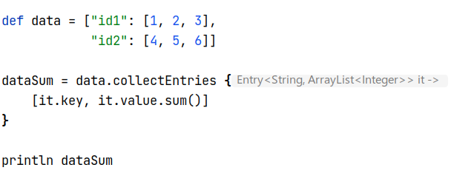

Why Groovy for unit test?
Java
verbose and ceremony
Groovy
Concise and expressive
compiles to Java class targeted in JVM
low learning curve – existing Java code can be used
optionally typed

Slide 5

Testing and specification framework for Java & Groovy applications
Beautiful and highly expressive specification language based on Groovy
Compatible with most IDEs
Spock

Slide 6
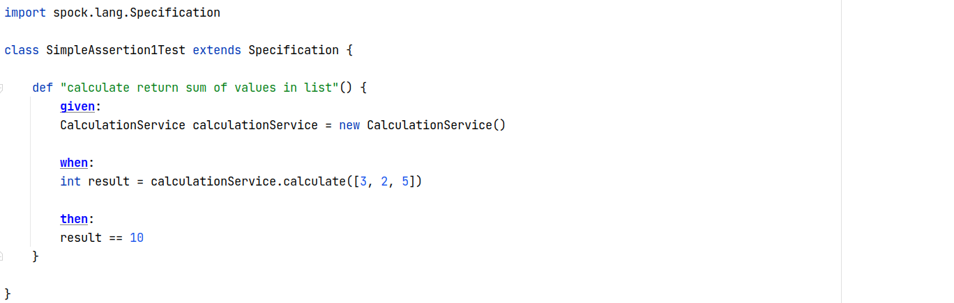
not using method name but full descriptions
behavior definition
given… when … then …
no assertion, but simple double equal operator ==
Simple Assertion I

Slide 7
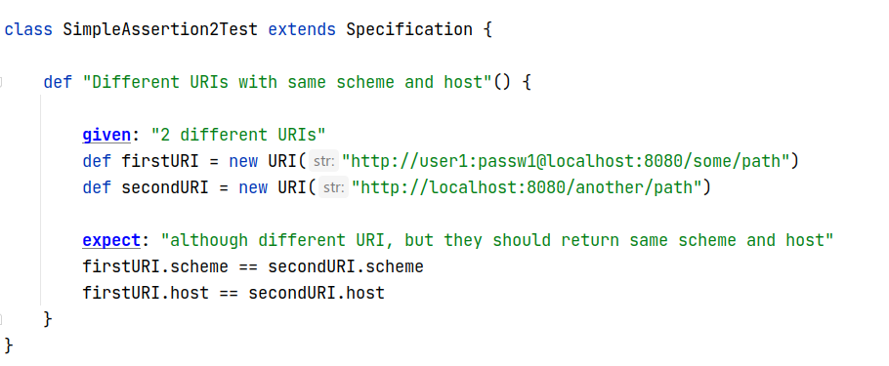
flexible labels
given… expect…
documentation of labels, easy to describe what’s hapenning
== for string equality
Simple Assertion II

Slide 8
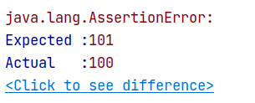
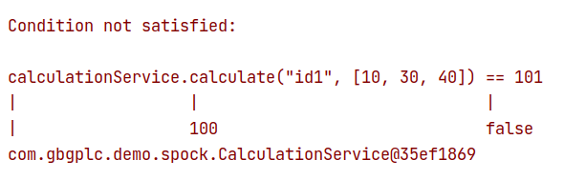
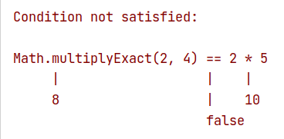
JUnit
Spock
Assertions Error

Slide 9
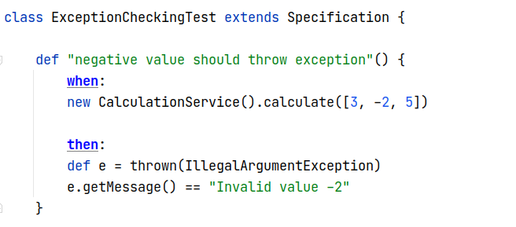
expect exception thrown
verify exception attributes
Exception

Slide 10
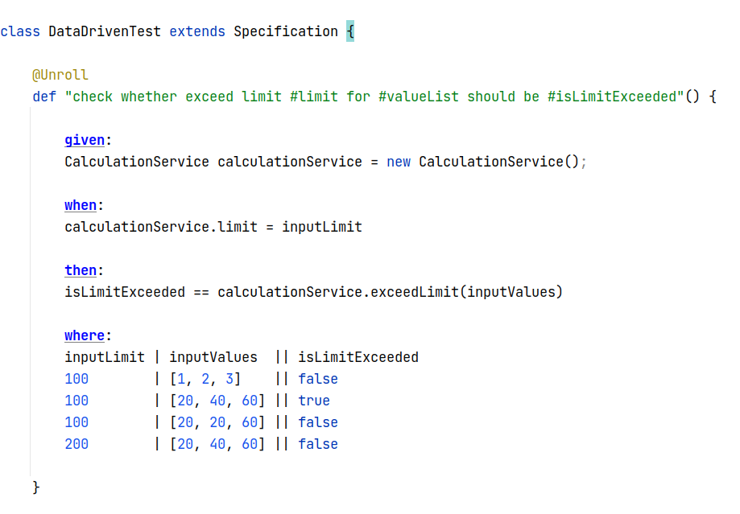
parameterized test description
unroll into multiple tests
data table
Data Driven

Slide 11
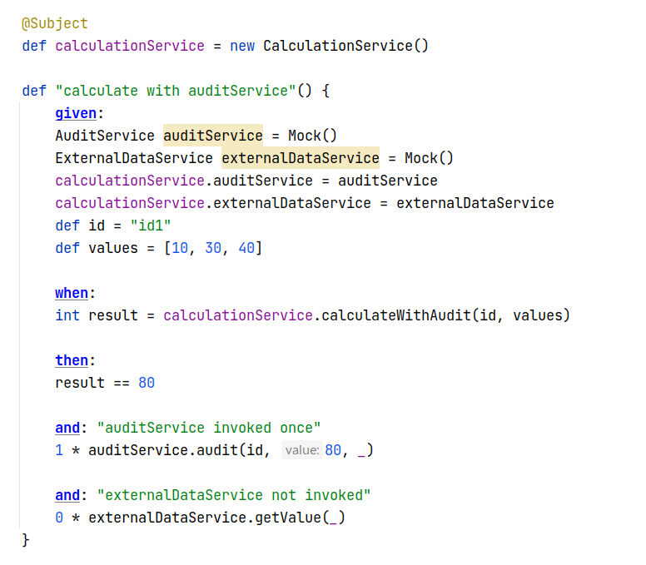
define test subject
built-in simple mock framework
verify mock interaction
Mocking

Slide 12
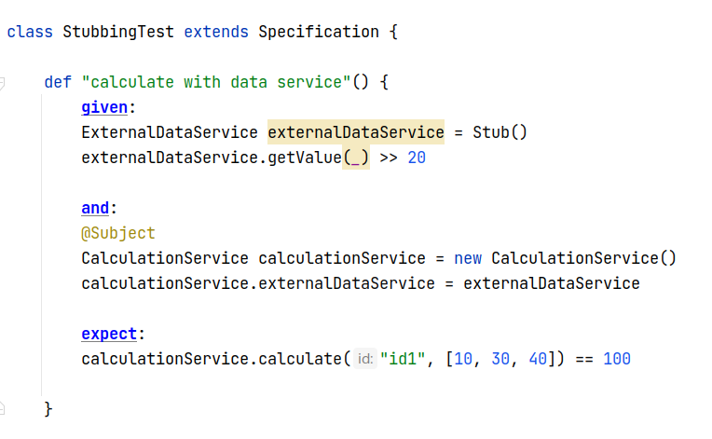
built-in simple stub framework
stub return value
Stubbing

Slide 13
Any questions?
source: https://github.com/engleong/spock-demo

